Slide 1

eCOI electronic Conflict of Interest
External Activity Reports (EARs)
Emory University, Office of Research Administration

Slide 2
Completing an External Activities Report
The purpose of the External Activity Report is to ensure that the arrangement does not interfere with the faculty member’s duties and responsibilities to the University.
Faculty are required to obtain prior approval from their Department Chair and Dean in order to participate in external activities with industry or other entities.

Slide 3
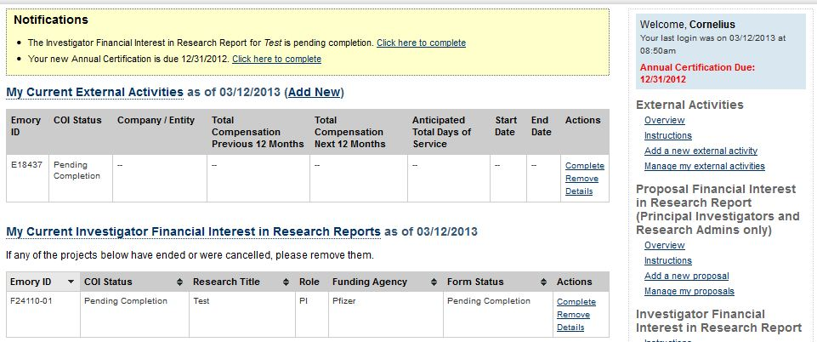
Instructions
Once you have logged into your eCOI home page, click “Add New” after “My Current External Activities” or in the “External Activities” section in the column at right.

Slide 4
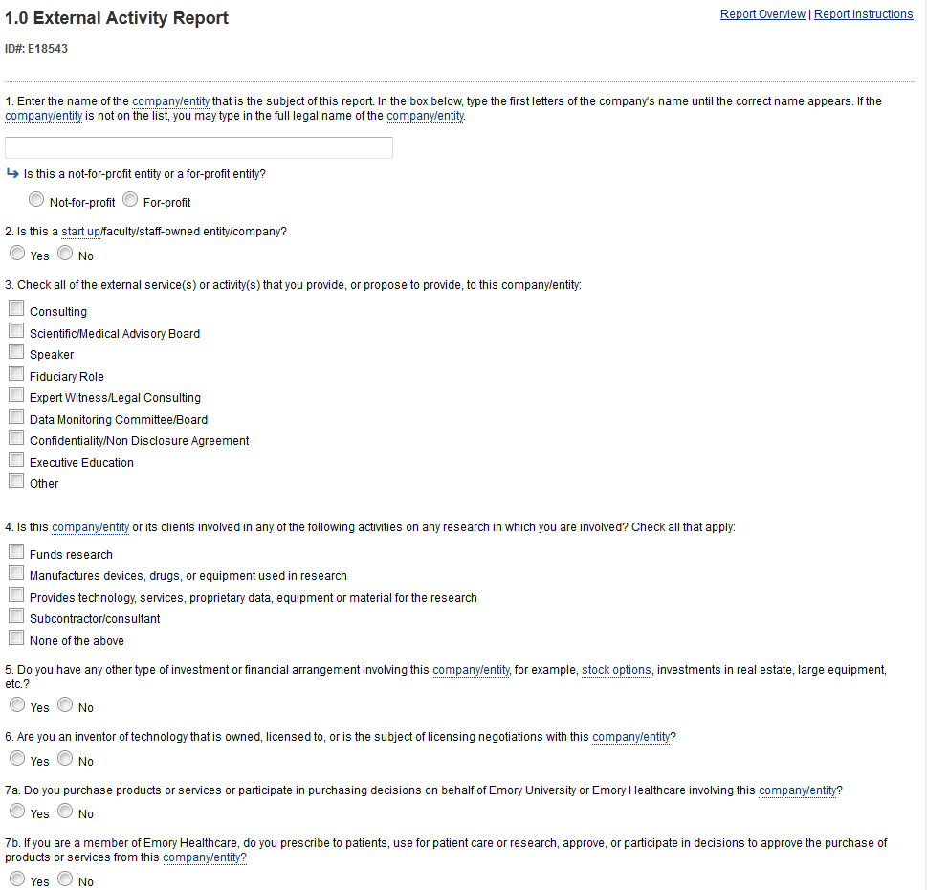
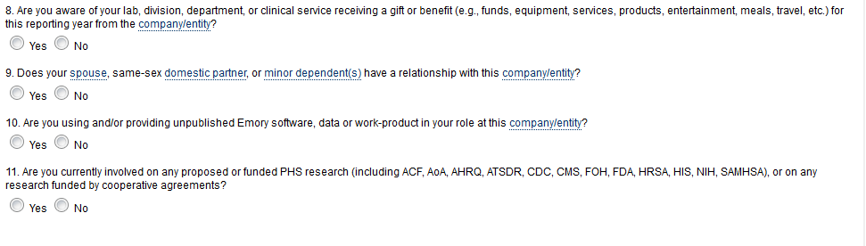
2. The next page will be a general overview regarding External Activity Reports. After carefully reading this page, click “continue”.
3. Complete the External Activity Report. Answer every question. After completing each page click “continue”.

Slide 5
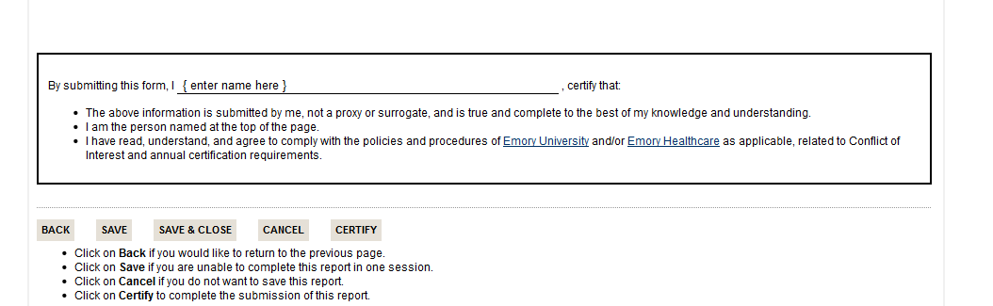
3. After completing the form, a summary of your answers should appear on your computer screen. Once you have made sure that all of your answers are accurate, type your name in the certification box and click “certify” at the bottom of the page.
Any changes to information collected through the External Activities Reports must be made within thirty days. The changes should be made through the eCOI system.

Slide 6
What Does Not Have to be Reported?
Traditional academic activities that usually are not reported include:
Invitations to lecture at another academic institution in which the honorarium, if any, is paid by the academic institution.
Invited presentations by academic professional associations and societies at their formal meetings and conferences in which the honorarium, if any, is paid by the professional society*.
Serving on a government advisory panel or a government grant review body, such as NIH, NEA, NSF, etc.
Speaking at accredited continuing education activities (such as CCME, CLE, etc,) hosted at other academic institutions and sponsored and managed by professional associations and societies*.

Slide 7
Need Additional Help?
Contact Emory’s Office of Research Administration for University Policy information:
1599 Clifton Road
6th Floor East
Atlanta, GA 30322
Phone: (404)712-0046
Fax: (404)712-0069
Email: COI-OFFICE@LISTSERV.CC.EMORY.EDU
Website: http://www.coi.emory.edu
Emory Mailstop: 1599 -001-1BU
Financial interests and clinical activities:
Please contact the Office of Compliance Programs at (404) 778-2757
External activities and school-based policies, please contact your Dean’s Office:
School of Medicine Nell Hodgson Woodruff School of Nursing
Zainab Wurie Harvey, JD Sandra B. Dunbar, DSN, FAAN
zwurie@emory.edu sbdunba@emory.edu
404-727-3407 404-727-6936
Emory College/Graduate Arts & Sciences Goizueta Business School
Carla Freeman, PhD Kristy Towry, PhD
cfree01@emory.edu kristy.towry@emory.edu
404-727-6059 404-727-4895
Rollins School of Public Health School of Law
Dean Surbey, MBA Polly J Price, JD
psurbey@emory.edu pprice@emory.edu
404-727-3023 404-727-7869

