Slide 1
eCOI electronic Conflict of Interest
Proposal Financial Interest in Research Reports (PFIRRs)
Emory University, Office of Research Administration

Slide 2
Completing a Proposal Financial Interest in Research Report
The purpose of this form is to identify projects with various ID numbers of different approval units, the funding source for the project, and the Investigators who will participate in the project in order to initiate the request for each to complete an Investigator Financial Interest in Research Report.
The research proposal's Research Administrator/Coordinator or Business Administrator, and Lead Principal Investigator are the only individuals authorized to submit a Proposal Financial Interest in Research Report.
A new form must be completed for each year of a project, continuing award or contract.

Slide 3
Instructions
1. From the eCOI home page, click on “add a new proposal” in the column on the right side of the screen.
2. The next page will be a general overview regarding Proposal Financial Interest in Research Reports. Clicking “continue” at the bottom of the page will take you to the second page, where you must determine whether the proposed project will be funded by an agency of the Public Health Service.

Slide 4
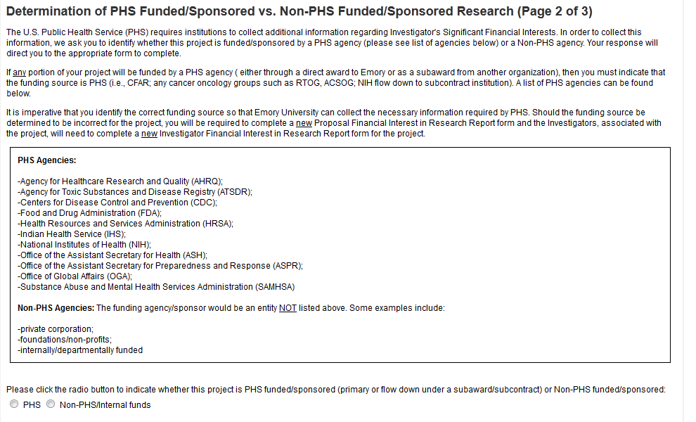
3. Choose PHS if primary funding source is a US Public Health Service Agency. Choose non-PHS if primary funding source is a private corporation, a foundation/ non-profit, or internally funded. Select “continue” at bottom of page.
Investigators on projects funded by the PHS are required to complete a different Investigator Financial Interest in Research Report in order to provide additional information required by federal regulations. Correctly identifying whether or not the project is funded by the PHS will ensure that the Investigators will be directed to the correct disclosure form.

Slide 5
You should now be on the third page. Complete the PFIRR form. Review and answer as many questions as you can. Only team members who fit the definition of Investigator should be added. Those team members will receive an email notification to complete an Investigator Financial Interest in Research Report, only if they have disclosed significant financial interests in the past year. External Investigators on an Emory PHS proposal/award must have their institutional official complete a consortium letter. If this is for a PHS study and they do not have a COI policy, then they must complete the External Investigator Report.
After completion, click “submit” at the bottom of the page. Please remember to return here to update changes made in other paper and electronic systems.

Slide 6
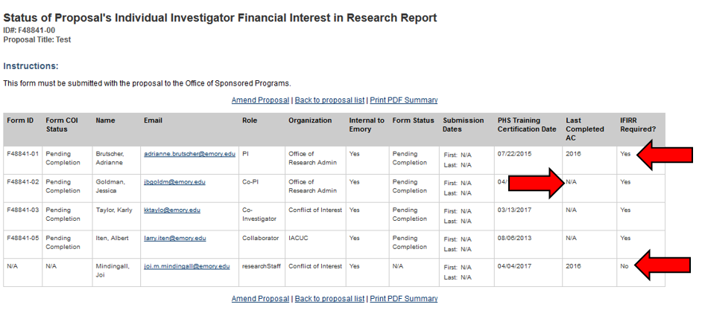
6. The Researcher Status Summary sheet will show which team members are required to complete an Investigator Financial Interest in Research Report, and, of those, which team members have done so. Notice, even if a team member has no significant financial interest, a current AC must be on file to be exempt from disclosing on each study.

Slide 7
7.The Summary Sheet can be made into a pdf and submitted to the Office of Sponsored Programs through EPEX.

Slide 8
Need Additional Help?
Contact Emory’s Office of Research Administration for University Policy information:
1599 Clifton Road
6th Floor East
Atlanta, GA 30322
Phone: (404)712-0046
Fax: (404)712-0069
Email: COI-OFFICE@LISTSERV.CC.EMORY.EDU
Website: http://www.coi.emory.edu
Emory Mailstop: 1599 -001-1BU
Financial interests and clinical activities:
Please contact the Office of Compliance Programs at (404) 778-2757
External activities and school-based policies, please contact your Dean’s Office:
School of Medicine Nell Hodgson Woodruff School of Nursing
Zainab Wurie Harvey, JD Sandra B. Dunbar, DSN, FAAN
zwurie@emory.edu sbdunba@emory.edu
404-727-3407 404-727-6936
Emory College/Graduate Arts & Sciences Goizueta Business School
Carla Freeman, PhD Kristy Towry, PhD
cfree01@emory.edu kristy.towry@emory.edu
404-727-6059 404-727-4895
Rollins School of Public Health School of Law
Dean Surbey, MBA Polly J Price, JD
psurbey@emory.edu pprice@emory.edu
404-727-3023 404-727-7869

