Slide 1

eCOI electronic Conflict of Interest
Investigator Financial Interest in Research Reports (IFIRRs)
Emory University, Office of Research Administration

Slide 2
Completing an Investigator Financial Interest in Research Report
    The purpose of this form is to identify which Significant Financial Interest might be related to a specific research project.
    All Investigators who have disclosed significant financial interests in the past year must complete this form before a project can begin. A summary report of all of the Investigator’s forms must be submitted with a grant or contract to the Office of Sponsored Programs.
    Significant Financial Interests held by the Investigator, as well as those held by his/her spouse/same-sex domestic partner or those held by dependent children must be reported if they are related to the Investigator’s Institutional Responsibilities.
    The form that must be completed for projects funded by the US Public Health Service (PHS) is different than the Investigator Financial Interest in Research Form that Investigators complete for projects that do not receive PHS funds.
    A new form must be completed for each year of a project, continuing award or contract.

Slide 3
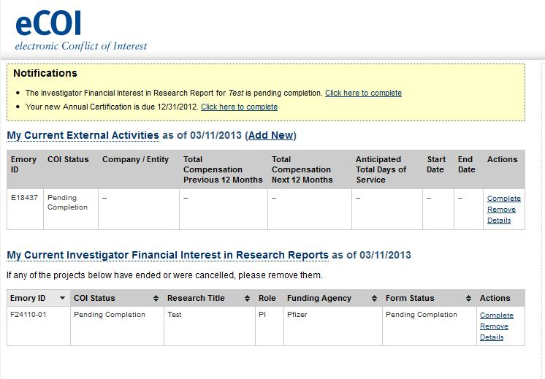
Instructions
1. Select one of two links on your eCOI homepage to access the Investigator Financial Interest in Research Report.

Slide 4
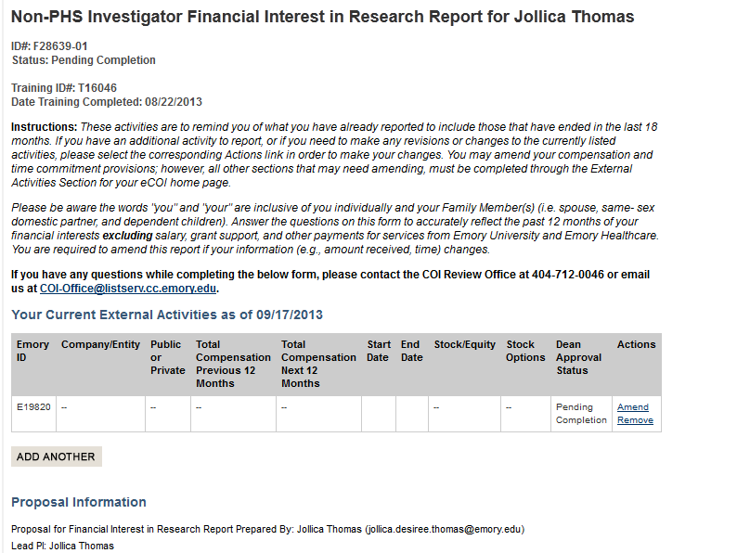
2 a. At the top of the non-PHS Investigator Financial Interest in Research Report, you will see all of the external activities that you have reported. If you have no external activities, none will be listed.
Using the “Amend” button, you must update the information as necessary.

Slide 5
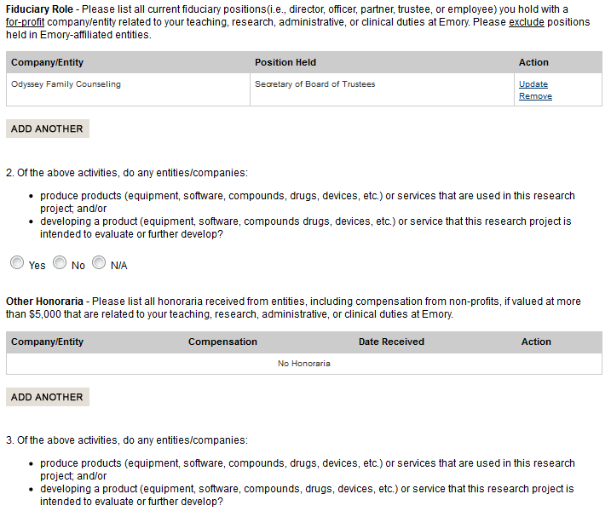
2 b. The PHS Investigator Financial Interest in Research Report has all of the different categories of financial interests that must be reported to comply Emory Policies. You should update and amend this information as needed. Any new Significant Financial Interest must be reported within 30 days of when you become aware of it.

Slide 6
3. Once directed to the appropriate page on the Investigator Financial Interest in Research Report, you must answer every question.
4. If you answer “Yes” to any of the questions, the form will ask you a few additional questions to better understand the relationship. You will be asked to identify whether you are the person with the financial relationship or to identify the family member who does and then to provide a short description of the relationship.
5. Once you have completed the form, type your name in the certification box and click “certify” at the bottom of the page.
6. You must complete any External Activity Reports that are added to your Investigator Financial Interest in Research Report. You will be sent an e-mail reminder and a new notification will appear on your eCOI homepage.

Slide 7
Need Additional Help?
Contact Emory’s Office of Research Administration for University Policy information:
1599 Clifton Road
6th Floor East
Atlanta, GA 30322
Phone: (404)712-0046
Fax: (404)712-0069
Email: COI-OFFICE@LISTSERV.CC.EMORY.EDU
Website: http://www.coi.emory.edu
Emory Mailstop: 1599 -001-1BU
Financial interests and clinical activities:
Please contact the Office of Compliance Programs at (404) 778-2757
External activities and school-based policies, please contact your Dean’s Office:
School of Medicine Nell Hodgson Woodruff School of Nursing
Zainab Wurie Harvey, JD Sandra B. Dunbar, DSN, FAAN
zwurie@emory.edu sbdunba@emory.edu
404-727-3407 404-727-6936
Emory College/Graduate Arts & Sciences Goizueta Business School
Carla Freeman, PhD Kristy Towry, PhD
cfree01@emory.edu kristy.towry@emory.edu
404-727-6059 404-727-4895
Rollins School of Public Health School of Law
Dean Surbey, MBA Polly J Price, JD
psurbey@emory.edu pprice@emory.edu
404-727-3023 404-727-7869

