Slide 1

eCOI electronic Conflict of Interest
Accessing eCOI and COI Training
Emory University, Office of Research Administration

Slide 2
Accessing eCOI
Firefox is recommended as your
Internet web browser for this program.
Other web browsers might have compatibility issues and the content of this system might look altered and/or may not function properly. The program does not work well on smart phones or tablet computers.
Instructions:
Open your internet web browser and type or copy/paste www.ecoi.emory.edu into the address bar.
or
Link to the web site by clicking “Enter eCOI” on Emory’s Conflict of Interest home page, located at www.coi.emory.edu.

Slide 3
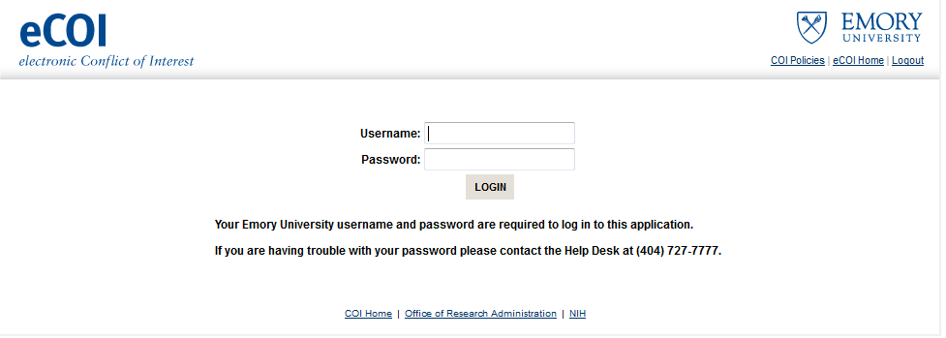
Log in to the system by using your Emory Network ID and Password (this is the same username and password that you use for PeopleSoft, Outlook, Virtual Desktop, etc.).

Slide 4
Welcome Page
Once you have logged in, you will see the eCOI Welcome Page.
If this is your first time using the application, it is highly recommended that you take the time to read this section.
Section Highlights:
Application usage
Who has access to this application
What you will need to get started
Who has access to your information
How do I know when my report is complete
Whom do I contact with questions
Once you finish reading this page, you may click on “eCOI Home”
in the upper right corner of the page.
or
You can scroll to the bottom of the page and click on “continue” to your homepage.

Slide 5
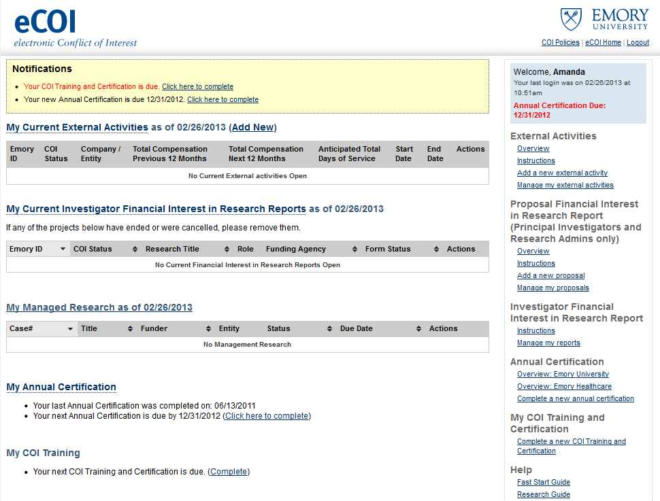
Your eCOI home page
System notifications and reminders
A list by company/entity of all of
reported external consulting agreements
A list by title of research projects
and proposals that identify you as a member of the research team
A list of any of research projects that are under a management plan
A reminder about when your next Annual Certification is due and when the last one was completed
A reminder about when your training certification is due and when the last one was completed
The navigation menu on the right side of the page provides an overview and instructional information about each type of report; this also includes links to view and manage reports.

Slide 6
COI Training
Federal regulations require that Institutions receiving funding from the US Public Health Service provide training to their Investigators about the federal regulations, the Institution’s policy, and Investigators’ responsibilities under the policy and regulations. The training is required to be documented and provided at least every four years.
eCOI has a one page training that provides access to regulations and policies.
To use eCOI for the first time, the training must be completed before any other forms can be initiated.

Slide 7
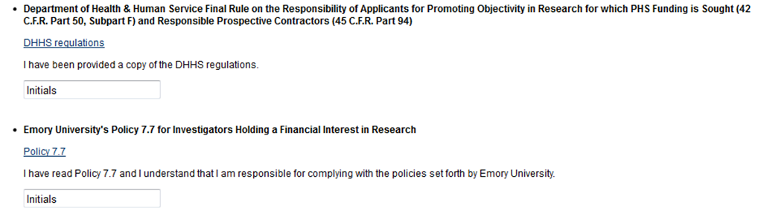

Completing Training
To complete the COI training, users must certify that they have read the policy, regulations, and understand their responsibilities.
Carefully read the DHHS regulations and Policy 7.7.
After reading both sections initial in the box under each link.
Once training is completed and submit button is clicked, the user will be taken back to the personalized eCOI home page.

Slide 8
Need Additional Help?
Contact Emory’s Office of Research Administration for University Policy information:
1599 Clifton Road
6th Floor East
Atlanta, GA 30322
Phone: (404)712-0046
Fax: (404)712-0069
Email: COI-OFFICE@LISTSERV.CC.EMORY.EDU
Website: http://www.coi.emory.edu
Emory Mailstop: 1599 -001-1BU
Financial interests and clinical activities:
Please contact the Office of Compliance Programs at (404) 778-2757
External activities and school-based policies, please contact your Dean’s Office:
School of Medicine Nell Hodgson Woodruff School of Nursing
Zainab Wurie Harvey, JD Sandra B. Dunbar, DSN, FAAN
zwurie@emory.edu sbdunba@emory.edu
404-727-3407 404-727-6936
Emory College/Graduate Arts & Sciences Goizueta Business School
Carla Freeman, PhD Kristy Towry, PhD
cfree01@emory.edu kristy.towry@emory.edu
404-727-6059 404-727-4895
Rollins School of Public Health School of Law
Dean Surbey, MBA Polly J Price, JD
psurbey@emory.edu pprice@emory.edu
404-727-3023 404-727-7869

